Slide 1

AI for Renewable Energy Optimization
Revolutionizing Energy Systems with Artificial Intelligence
Enhancing energy efficiency through intelligent solutions
Presented by
Ben Sadok Mohamed Elhedi M1
Date DEC 2024

Slide 2

Problem
The Challenge
Describe the key issues in renewable energy management:Rising global energy demand with a
35% increase expected by 2030.
Inefficiencies in energy generation and distribution (25% loss during transmission).
Limited integration of advanced AI technologies in optimizing systems.
Environmental concerns: Carbon emissions contributing to global warming and resource wastage.
Problem Area | Description
Energy Inefficiency | Wasted energy in networks
Environmental Impact | Increased carbon emissions
Limited AI Integration | Manual processes dominate

Slide 3

Solution
Our Approach
Introduce the AI-powered platform for energy optimization:Predictive Modeling:
Anticipates energy supply and demand patterns.
Real-Time Analytics: Minimizes waste and boosts efficiency.
Seamless Integration: Works with renewable energy sources like solar and wind.
Feature | Traditional Methods | AI-Powered Solution
Efficiency Improvement | 10%-15% | 25%-30%
Energy Prediction Accuracy | Energy Prediction Accuracy | Energy Prediction Accuracy
Cost Savings | Cost Savings | Cost Savings

Slide 4

Value Proposition
Why Choose Our Solution?
Efficiency boost: Reduces operational costs by 20-25%
Sustainability: Decreases carbon footprint by 10% globally
Scalability: Suitable for large-scale and small-scale energy systems.
Compliance: Helps meet global environmental goals (Paris Agreement, SDGs).
Stakeholder | Value Provided
Energy Providers | Cost savings and efficiency
Governments | Achieve sustainability goals
Large Businesses | Reduced operational costs

Slide 5
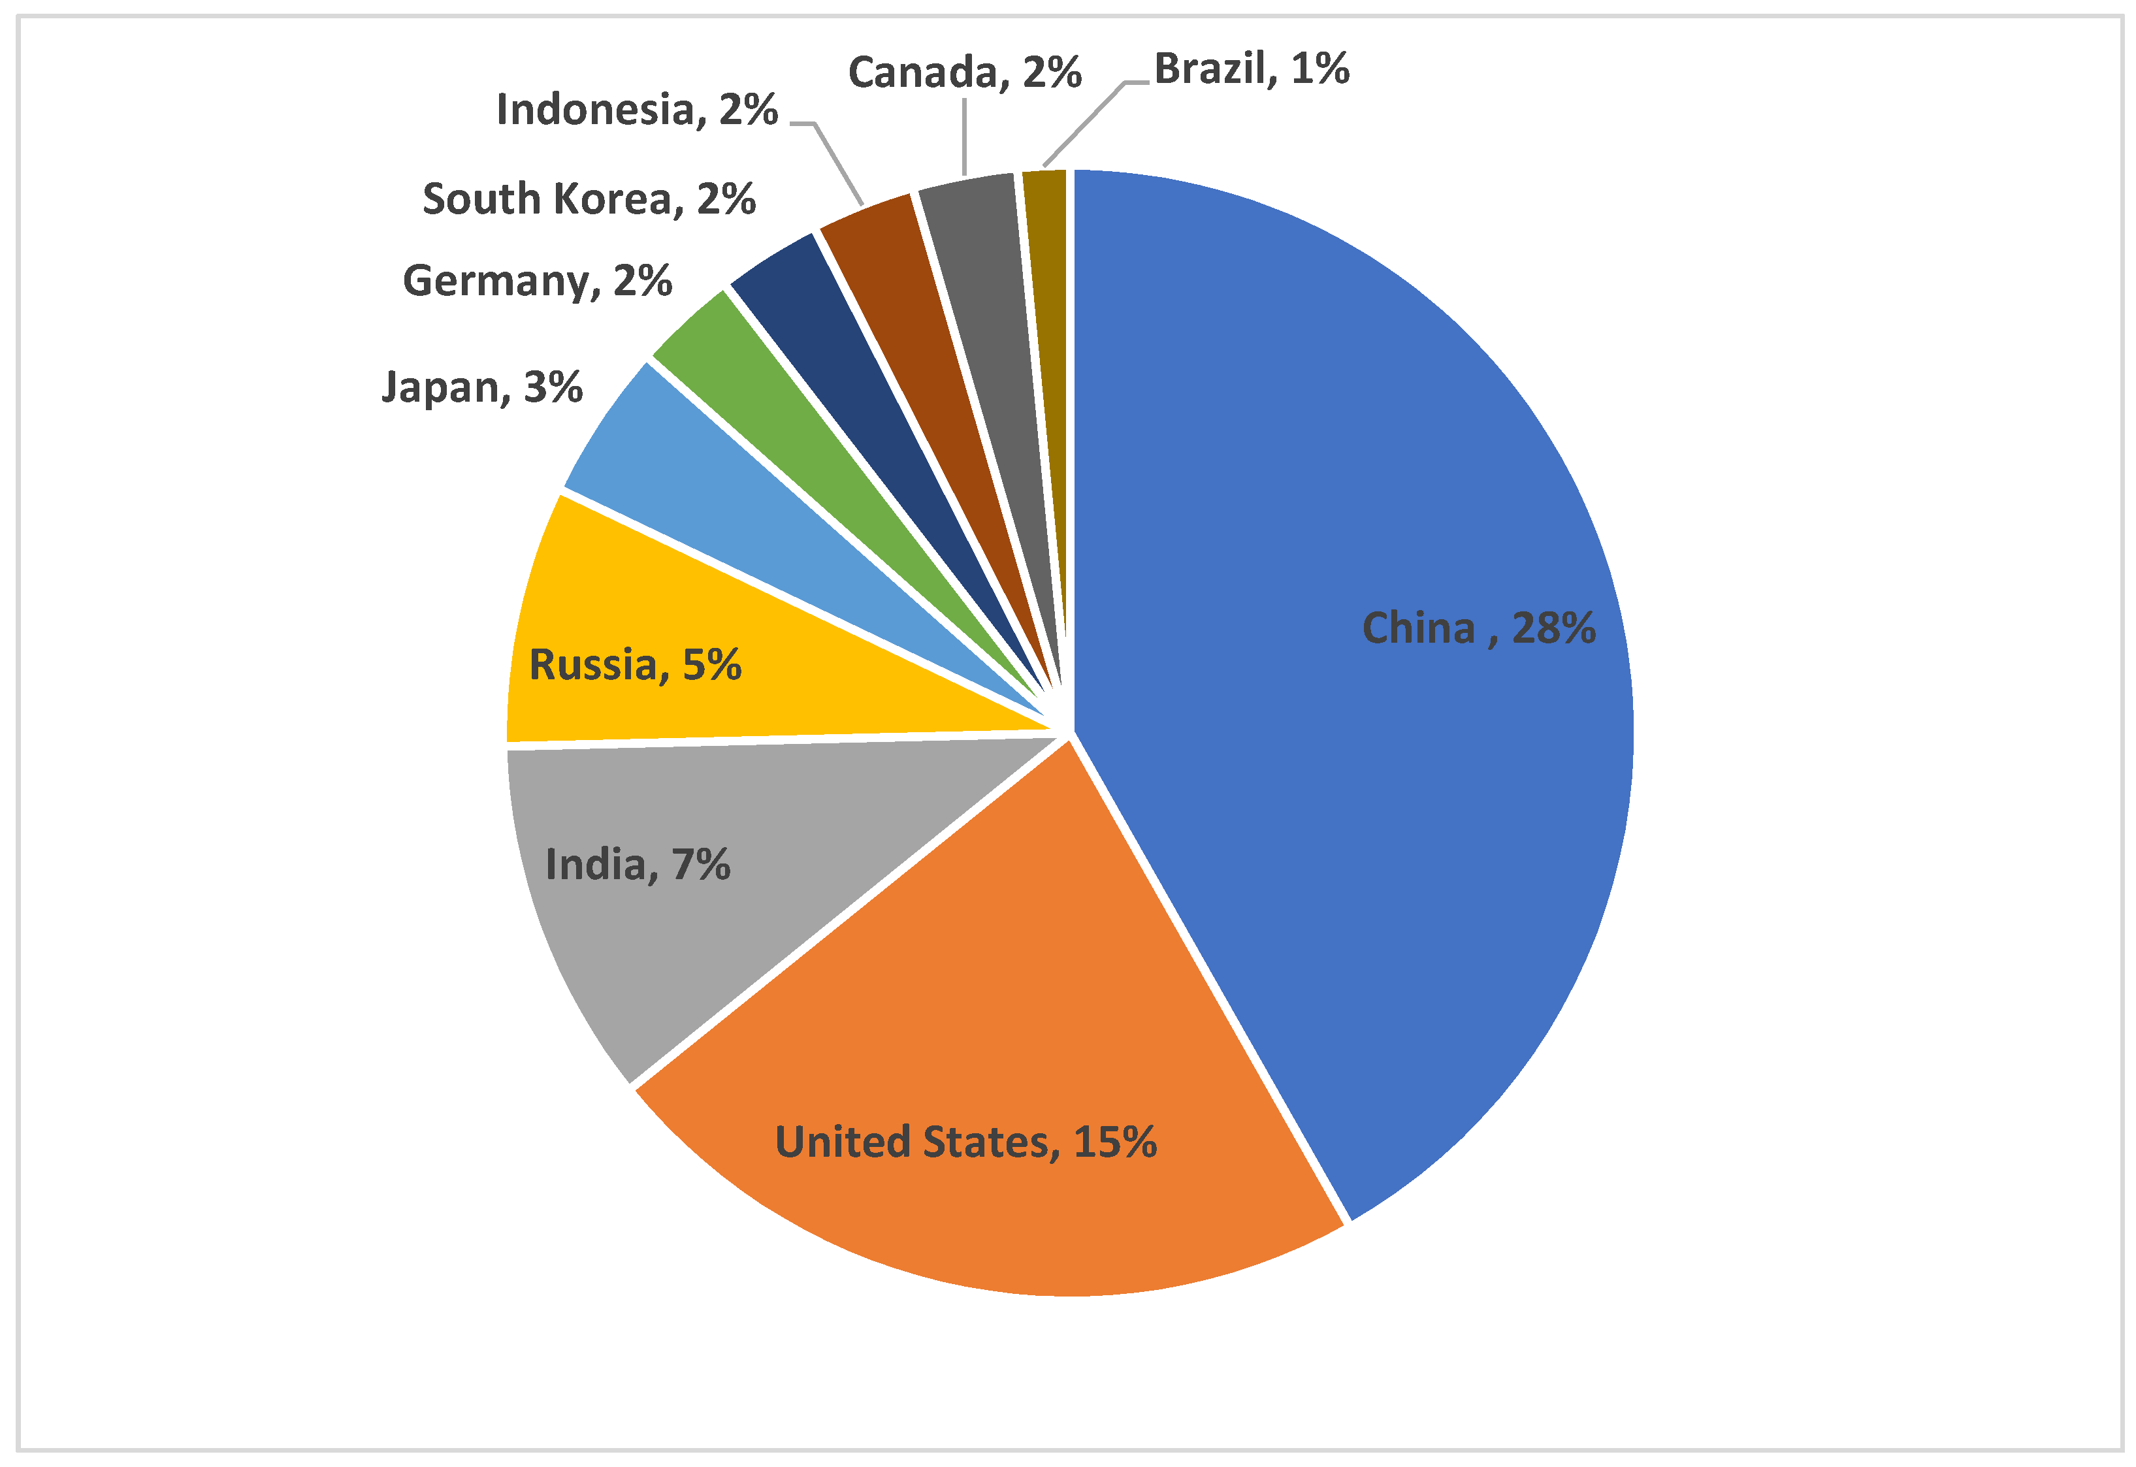
Environmental Impact
Positive Outcomes
Explain the positive ecological results:
Reduction in greenhouse gas emissions by 20%.
Promotion of clean energy adoption across industries.
Contribution to achieving SDGs like affordable clean energy.
Metric | Traditional Approach | AI-Powered Approach
Carbon Emissions | 30% | 20%
Resource Utilization | 60%-70% | 85%-90%

Slide 6

Target Market
Who Benefits?
Primary market: Utilities and energy providers.
Secondary market: Governments and businesses with high energy needs.
Emerging market: Consumers seeking efficient energy solutions.
Segment | Description
Utilities | Large-scale energy managers
Governments | Green initiative projects
Businesses | Energy-intensive industries

Slide 7

Market Analysis
Market Opportunity
Renewable energy market projected to hit $1.5 trillion by 2030.
AI energy solutions CAGR of 12%.
Year | Market Value ($) | CAGR (%)
2023 | $500 billion | 8%
2030 | $1.5 trillion | 12%

Slide 8

Competition
Competitive Landscape
Analyze competitors and highlight advantages:
AutoGrid : Established but lacks advanced AI.
Enel X : Affordable but limited scalability.
Competitor | Strengths | Weaknesses | Our Edge
AutoGrid | Established brand | Lacks AI | Real-time analytics
Enel X | Affordable | Low scalability | High scalability

Slide 9

Benchmarking
Industry Standards
Show how your platform outperforms benchmarks:
Prediction accuracy exceeds industry average by 10%.
Cost reduction is 15% higher than competitors.
Metric | Industry Avg. | Our Platform
Prediction Accuracy | 85% | 92%
Cost Reduction | 15% | 20%

Slide 10

Revenue Streams
Monetizing Our Solution
Subscription model for energy providers.
Custom analytics modules for businesses.
Licensing fees for government and large firms.
Revenue Stream | Description
Subscription | Monthly recurring fees
Licensing | Long-term contracts

Slide 11

Team
Meet the Team
Introduce key members with roles and expertise.
Highlight partnerships with energy and tech firms.

Slide 12

Thank You
Thank You for Your Attention
bensadokmohamedelhedi8@gmail.com

